Slide 1
NETWORK LAYER
CHAPTER 4

Slide 2
Contents
4.1.1 Network layer design issues
4.1.2 Communication primitives: Unicast, Multicast, Broadcast
4.1.3 IPV4 addressing :
Classful addressing
Classless addressing
Subnetting
Supernetting
Design problems
4.1.4 IPV4 Protocol
4.1.5 Network Address Translation

Slide 3
Contents
4.2 Routing Algorithms
4.2.1 Shortest Path (Dijkastra’s)
4.2.2 Linkstate Routing
4.2.3 Distance vector routing
4.3 Protocols at network layer
ARP, RARP,ICMP,IGMP
4.4 Congestion Control
4.4.1 Open Loop congestion control and close loop
4.4.2QoS parameters
4.4.3 Token bucket and leaky bucket algorithm

Slide 4
Network Layer Design Issues
The network layer design issues include the issues related to
Services provided to the transport layer and
The internal design of a subnet

Slide 5
Network Layer Design Goals
The services provided by the network layer should be independent of the subnet topology.
The Transport Layer should be shielded from the number, type and topology of the subnets present.
The network addresses available to the Transport Layer should use a uniform numbering plan (even across LANs and WANs).

Slide 6
Switching Techniques
Two types of switching
Circuit switching
Packet switching

Slide 7
Circuit switching
Circuit switching:
There is a dedicated communication path between two stations (end-to-end)
The path is a connected sequence of links between network nodes. On each physical link, a logical channel is dedicated to the connection.
Communication via circuit switching has three phases:
Circuit establishment (link by link)
Routing & resource allocation (FDM or TDM)
Data transfer
Circuit disconnect
De-allocate the dedicated resources
The switches must know how to find the route to the destination and how to allocate bandwidth (channel) to establish a connection.

Slide 8
Circuit switching properties
Inefficiency
Channel capacity is dedicated for the whole duration of a connection
If no data, capacity is wasted
Delay
Long initial delay: circuit establishment takes time
Low data delay: after the circuit establishment, information is transmitted at a fixed data rate with no delay other than the propagation delay. The delay at each node is negligible.
Developed for voice traffic (public telephone network) but can also applied to data traffic.
For voice connections, the resulting circuit will enjoy a high percentage of utilization because most of the time one party or the other is talking.
But how about data connections?

Slide 9
Packet Switching
Data are transmitted in short packets
Typically at the order of 1000 bytes
Longer messages are split into series of packets
Each packet contains a portion of user data plus some control info
Control info contains at least
Routing (addressing) info, so as to be routed to the intended destination
Recall the content of an IP header!
Store and forward
On each switching node, packets are received, stored briefly (buffered) and passed on to the next node.

Slide 10
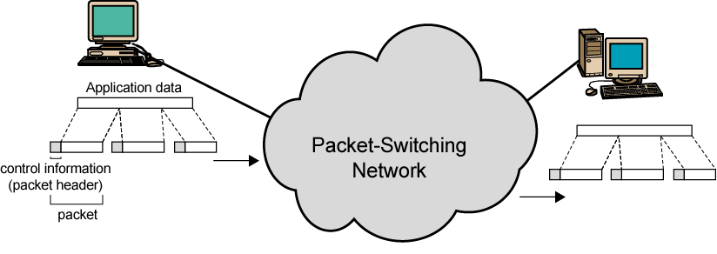
Packet switching

Slide 11
Advantages of packet switched network
Line efficiency
Single node-to-node link can be dynamically shared by many packets over time
Packets are queued up and transmitted as fast as possible
Data rate conversion
Each station connects to the local node at its own speed
In circuit-switching, a connection could be blocked if there lacks free resources. On a packet-switching network, even with heavy traffic, packets are still accepted, by delivery delay increases.
Priorities can be used
On each node, packets with higher priority can be forwarded first. They will experience less delay than lower-priority packets.

Slide 12
Packet Switching Technique
A station breaks long message into packets
Packets are sent out to the network sequentially, one at a time
How will the network handle this stream of packets as it attempts to route them through the network and deliver them to the intended destination?
Two approaches
Datagram approach
Virtual circuit approach

Slide 13
IMPORTANT
The network layer is designed as a packet-switched network

Slide 14
Implementation of Connectionless service - Datagram subnet
Each packet is treated independently, with no reference to packets that have gone before.
Each node chooses the next node on a packet’s path.
Packets can take any possible route.
Packets may arrive at the receiver out of order.
Packets may go missing.
It is up to the receiver to re-order packets and recover from missing packets.
Example: Internet

Slide 15
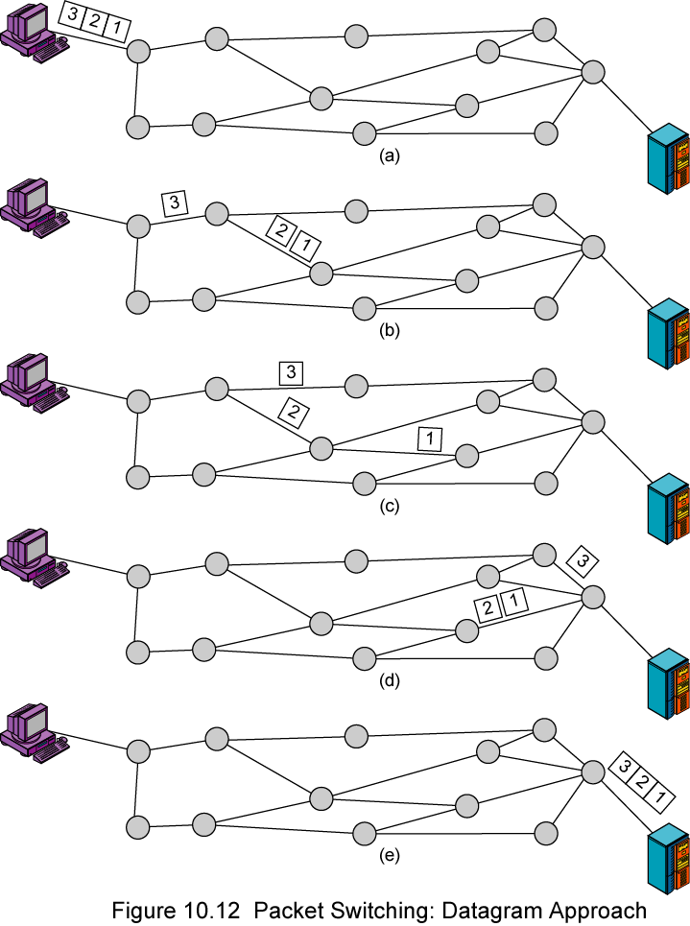
Datagram

Slide 16
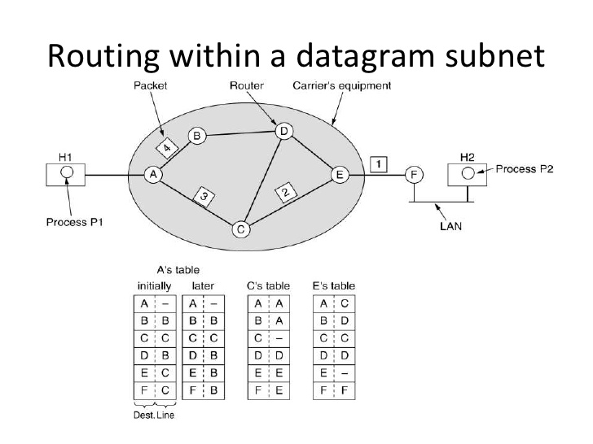

Slide 17
Implementation of Connection oriented service using Virtual Circuits
In virtual circuit, a preplanned route is established before any packets are sent, then all packets follow the same route.
Each packet contains a virtual circuit identifier instead of destination address, and each node on the pre-established route knows where to forward such packets.
The node need not make a routing decision for each packet.
Example: X.25, Frame Relay, ATM

Slide 18
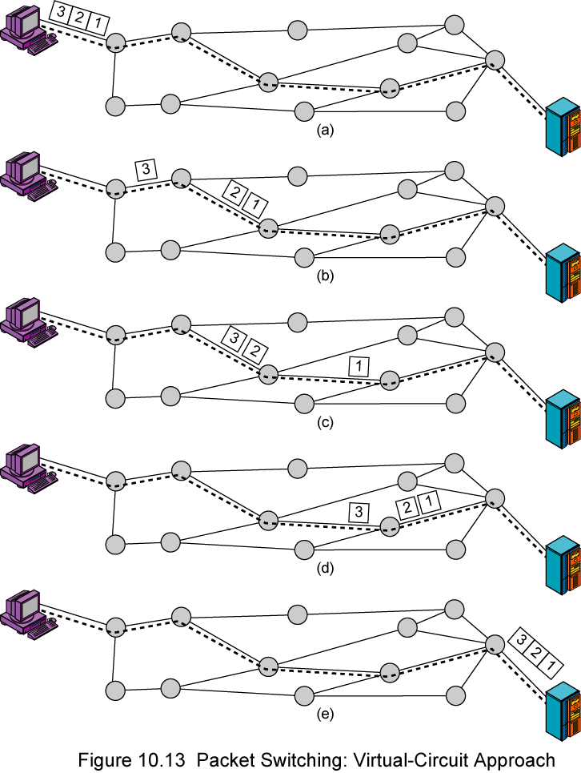
Virtual Circuit
A route between stations is set up prior to data transfer.
All the data packets then follow the same route.
But there is no dedicated resources reserved for the virtual circuit! Packets need to be stored-and-forwarded.

Slide 19
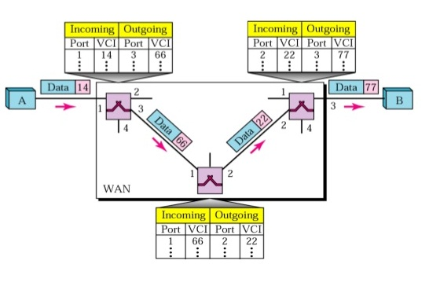
Routing In Virtual circuits

Slide 20
Virtual Circuits vs. Datagram
Virtual circuits
Network can provide sequencing (packets arrive at the same order) and error control (retransmission between two nodes).
Packets are forwarded more quickly
Based on the virtual circuit identifier
No routing decisions to make
Less reliable
If a node fails, all virtual circuits that pass through that node fail.
Datagram
No call setup phase
Good for bursty data, such as Web applications
More flexible
If a node fails, packets may find an alternate route
Routing can be used to avoid congested parts of the network

Slide 21
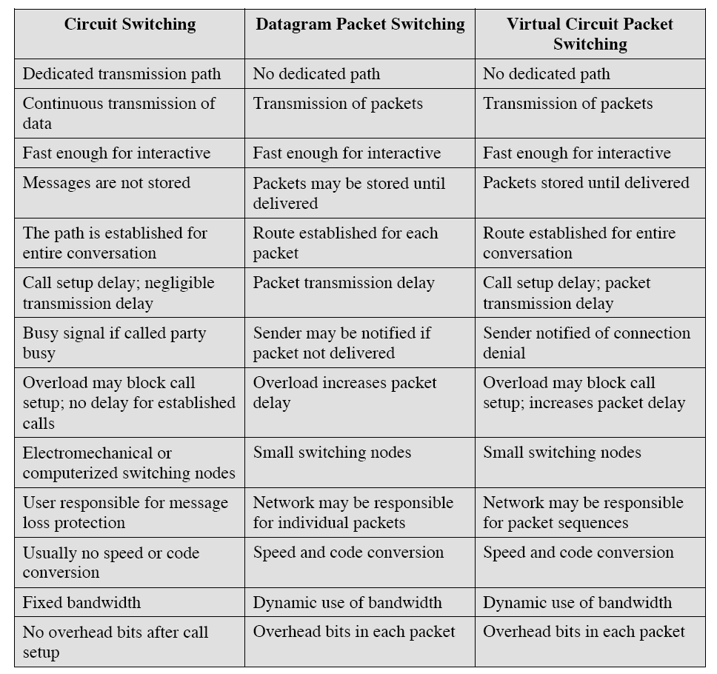
Comparison of three techniques

Slide 22
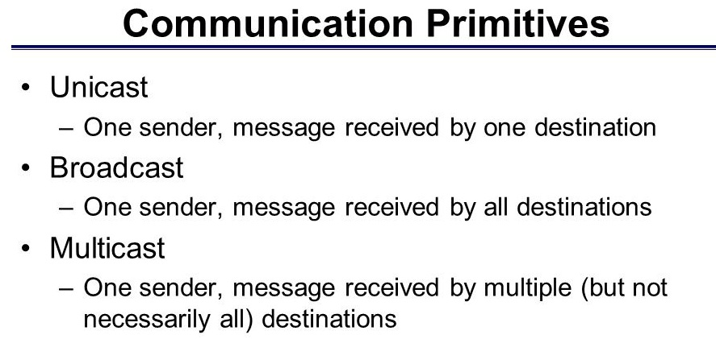

Slide 23
Special IP addresses
Addresses significant to every IP subnet
Network Address
Broadcast Address
Addresses significant to individual hosts
Loopback Address
Special Addresses of Global Significance
Private Addresses
Reserved Addresses

Slide 24
Network address
A network address is an address where all host bits in the IP address are set to zero (0).
In every subnet there is a network address. This is the first and lowest numbered address in the range because the address is always the address where all host bits are set to zero.

Slide 25
Broadcast address
A broadcast address is an address where all host bits in the IP address are set to one (1).
This address is the last address in the range of addresses, and is the address whose host portion is set to all ones. All hosts are to accept and respond to the broadcast address. This makes special services possible.

Slide 26
Loopback address
The 127.0.0.0 class 'A' subnet is used for special local addresses, most commonly the loopback address 127.0.0.1.
This address is used to test the local network interface device's functionality. All network interface devices should respond to this address from the command line of the local host.
If you ping 127.0.0.1 from the local host, you can be assured that the network hardware is functioning and that the network software is also functioning.
The addresses in the 127.0.0.0 - 127.255.255.255 range cannot be reached from outside the host, and so cannot be used to build a LAN.

Slide 27
Private addresses
RFC 1918 defines a number of IP blocks which were set aside by the American Registry of Internet Numbers (ARIN) for use as private addresses on private networks that are not directly connected to the Internet. The private addresses are:
Class | Start | End
A | 10.0.0.0 | 10.255.255.255
B | 172.16.0.0 | 172.31.255.255
C | 192.168.0.0 | 192.168.255.255

Slide 28
Multicast IP Addresses
There are a number of addresses that are set aside for special purposes, such as the IP's used in OSPF, Multicast, and experimental purposes that cannot be used on the Internet.
Class | Start | End
D | 224.0.0.0 | 239.255.255.255

Slide 29
Network Address Translation (NAT)
Primarily NAT was introduced to the world of IT and networking due to the lack of IP addresses.
NAT uses the range of private addresses.
Class A 10.0.0.0 - 10.255.255.255
Class B 172.16.0.0 - 172.31.255.255
Class C 192.168.0.0 - 192.168.255.255
NAT allows you to use these private IP address on the internal network.
Another company can use the same private IP addresses as well, as long as they are kept internal to their network

Slide 30
Network Address Translation (NAT)
When a host on the internal network with an internal IP address does need to communicate outside it's private network, it would use the public IP address on the network's gateway to identify itself to the rest of the world, and this translation of converting a private IP address to public is done by NAT.
Usually NAT is implemented at border networks such as firewalls or routers

Slide 31
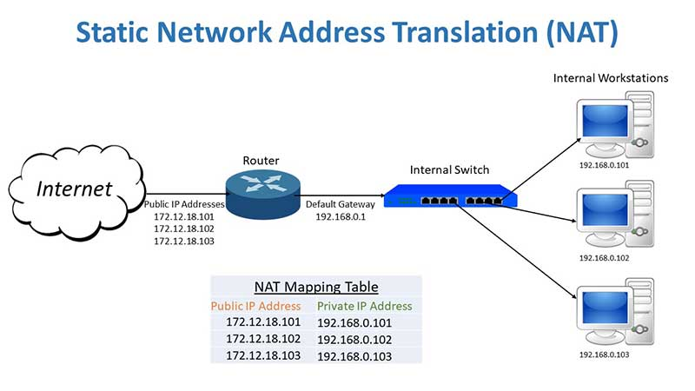
EXAMPLE - NAT

Slide 32
Advantages of NAT
Public IP address sharing
Easier expansion
Greater local control
Increased security

Slide 33
Internet Protocol IPv4
The Internet Protocol (IP) is the transmission mechanism used by the TCP/IP protocols at the network layer.

Slide 34
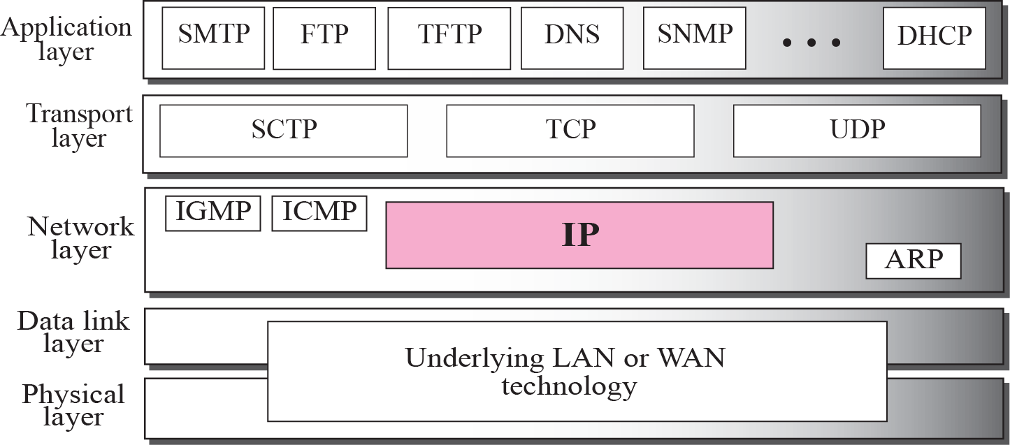
Position of IP in TCP/IP protocol suite

Slide 35
DATAGRAMS
Packets in the network (internet) layer are called datagrams.
A datagram is a variable-length packet consisting of two parts: header and data.

Slide 36
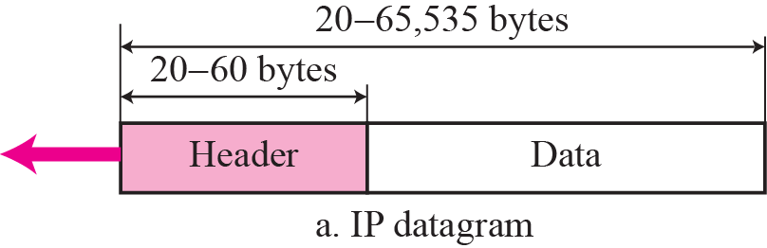
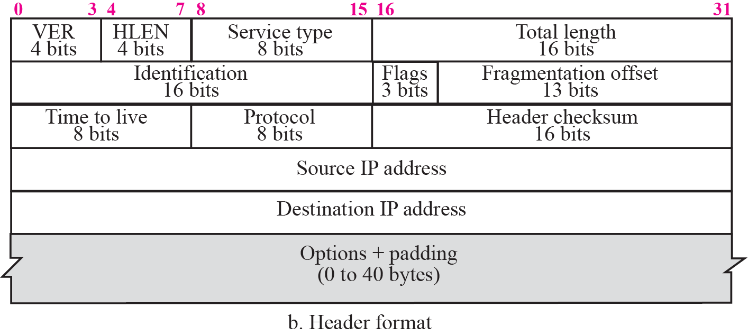
IP datagram

Slide 37
IPv4 Header
The header is 20 to 60 bytes in length and contains information essential to routing and delivery.
It is customary in TCP/IP to show the header in 4-byte sections. A brief description of each field is in order.

Slide 38
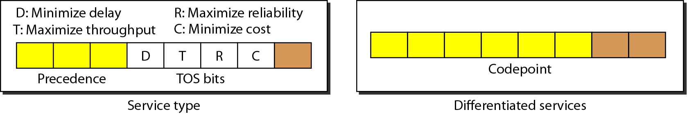
IPv4 Format
Version (4-bit): currently 4 for IPv4.
Header length (4-bit): the length of the IP header in 4-byte unit (i.e. 32 bit word).
Type of Services(TOS):
This field was not used earlier because of the lack of standard
DiffServ uses this field for differentiate packet types.
Differentiated Services: The ISP can define different service classes with corresponding forwarding rules. If a customer signs up for DS, then customer packet entering the internet may carry type of service field. With better services provided to some classes.(e.g. premium service) than to others.

Slide 39
IPv4 Format
Identification
A source node gives a unique ID to each packet if packets are fragmented.
Identification, Flags, Fragmentation offset fields are used for fragmentation (will be covered later)
Time to Live (TTL)
A packet has a limited lifetime in the network to avoid zombie packets.
Designed to hold a timestamp, and decreased by each router. A packet is discarded by a router if TTL is zero.
Revised to hold the maximum number of hops the packet can travel thru the network. Each router decrements it by one.
Protocol
To define payload protocol type
1 for ICMP
2 for IGMP
6 for TCP
17 for UDP
89 for OSPF

Slide 40
IPv4 Format
Header checksum
An IP header is slightly modified by each router. At least TTL field.
So must be computed by each router.
The checksum must be efficiently calculated with no need of special hardware.
Uses checksum method (using 1’s complement arithmetic)
Source IP address and Destination IP address
Options
Variable length
For new protocols
Padding
To make the header a multiple of 32-bit words

Slide 41
OPTIONS Field
The header of the IP datagram is made of two parts: a fixed part and a variable part. The fixed part is 20 bytes long and was discussed in the previous section. The variable part comprises the options, which can be a maximum of 40 bytes.
Options, as the name implies, are not required for a datagram. They can be used for network testing and debugging. Although options are not a required part of the IP header, option processing is required of the IP software.

Slide 42
Option field
Security – How secret the data gram is
strict source routing – Gives the complete path to follow
Loose source routing – Gives the list of routers not to be missed
Record route – makes each router appends its IP address to option field
Time stamp - each router appends its IP address and time stamp

Slide 43
Figure Record-route concept
4
8

Slide 44
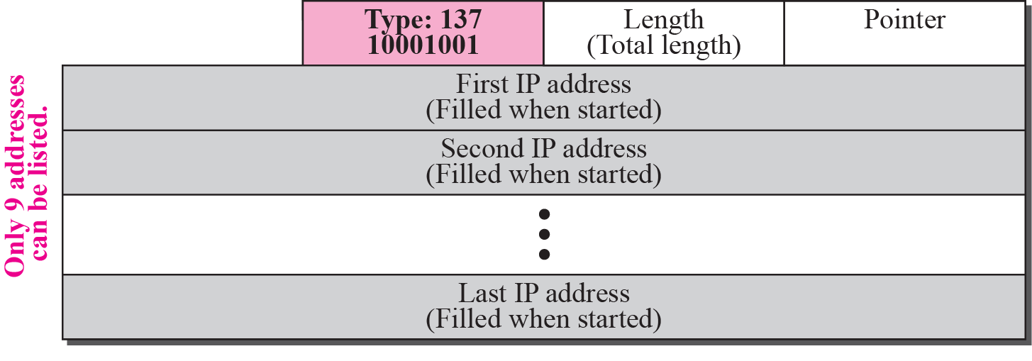
Figure Strict-source-route option

Slide 45

Note
The total length field defines the total length of the datagram including the header.

Slide 46

Encapsulation of a small datagram in an Ethernet frame

Slide 47
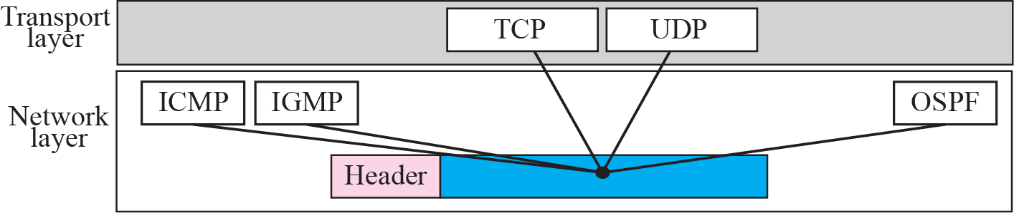
Figure 7.5 Multiplexing

Slide 49
Example 1
An IP packet has arrived with the first 8 bits as shown:
The receiver discards the packet. Why?
Solution
There is an error in this packet. The 4 left-most bits (0100) show the version, which is correct. The next 4 bits (0010) show the wrong header length (2 × 4 = 8). The minimum number of bytes in the header must be 20. The packet has been corrupted in transmission.

Slide 50
Example 2
In an IP packet, the value of HLEN is 1000 in binary. How many bytes of options are being carried by this packet?
Solution
The HLEN value is 8, which means the total number of bytes in the header is 8 × 4 or 32 bytes. The first 20 bytes are the base header, the next 12 bytes are the options.

Slide 51
Example 3
In an IP packet, the value of HLEN is 5₁₆ and the value of the total length field is 0028₁₆. How many bytes of data are being carried by this packet?
Solution
The HLEN value is 5, which means the total number of bytes in the header is 5 × 4 or 20 bytes (no options). The total length is 40 bytes, which means the packet is carrying 20 bytes of data (40 − 20).

Slide 52
FRAGMENTATION
A datagram can travel through different networks. Each router decapsulates the IP datagram from the frame it receives, processes it, and then encapsulates it in another frame. The format and size of the received frame depend on the protocol used by the physical network through which the frame has just traveled. The format and size of the sent frame depend on the protocol used by the physical network through which the frame is going to travel.

Slide 53
Topics Discussed in the Section
Maximum Transfer Unit (MTU)
Fields Related to Fragmentation

Slide 54

Figure 7.6 MTU

Slide 55
Note
Only data in a datagram is fragmented.

Slide 56

Figure Flags field

Slide 57
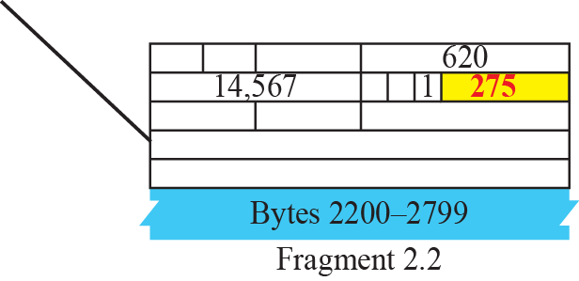
Figure Detailed fragmentation example

Slide 58
Example
We can also use the ping utility with the -R option to implement the record route option. The result shows the interfaces and IP addresses.

Slide 59
Example
The traceroute utility can also be used to keep track of the route of a packet. The result shows the three routers visited.

Slide 60
Example 7
The traceroute program can be used to implement loose source routing. The -g option allows us to define the routers to be visited, from the source to destination. The following shows how we can send a packet to the fhda.edu server with the requirement that the packet visit the router 153.18.251.4.

Slide 61
Example 7.16
The traceroute program can also be used to implement strict source routing. The -G option forces the packet to visit the routers defined in the command line. The following shows how we can send a packet to the fhda.edu server and force the packet to visit only the router 153.18.251.4.

Slide 62
Network Address Translation
Primarily NAT was introduced to the world of IT and networking due to the lack of IP addresses.
NAT uses the range of private addresses.
Class A 10.0.0.0 - 10.255.255.255
Class B 172.16.0.0 - 172.31.255.255
Class C 192.168.0.0 - 192.168.255.255
NAT allows you to use these private IP address on the internal network.
Another company can use the same private IP addresses as well, as long as they are kept internal to their network

Slide 63
NAT
Another company can use the same private IP addresses as well, as long as they are kept internal to their network.
When a host on the internal network with an internal IP address does need to communicate outside it's private network, it would use the public IP address on the network's gateway to identify itself to the rest of the world, and this translation of converting a private IP address to public is done by NAT.

Slide 64
What is Routing
Deciding which output line an incoming packet should be transmitted on.
Two terms
1) Forwarding
2) Routing

Slide 65
Routing algorithm
Can be grouped into two categories
1) Non-adaptive (static)
Does not take into account the change in the topology and current traffic. Routes are computes once and loaded into the router when network is booted.
2) Adaptive
Change their routing decisions to reflect change in topology and current traffic.
Routes are updated periodically.

Slide 66
Desirable properties of routing algorithm
Correctness -
Simplicity
Robustness- Robust against the failure of routers and change in topology
Stability- Should converge to equilibrium
Fairness – should not favor one node/source
Optimality- Optimizing certain parameters
- maximize throughput
- Minimize mean packet delay
- Minimizing queuing delay

Slide 67
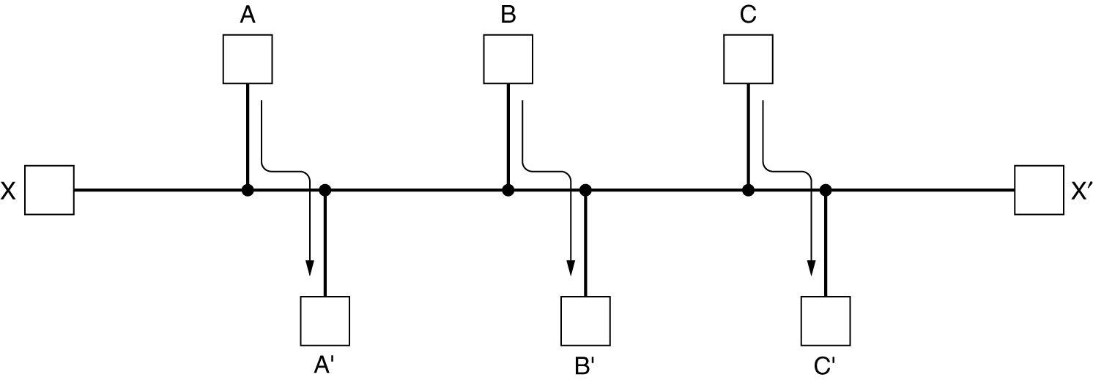
Routing Algorithms (2)
Conflict between fairness and optimality.

Slide 68
Optimality principle
If router J is on optimal path from router I to router K , then optimal path from J to k also falls along the same route.
A direct consequence of an optimality principle , is the sink tree.
Set of optimal routes from all sources to a given destination from a tree rooted at the destination is called sink tree.
Since the sink tree is a tree there are no loops, hence each packet will be guaranteed to be delivered in finite number of hops.

Slide 69
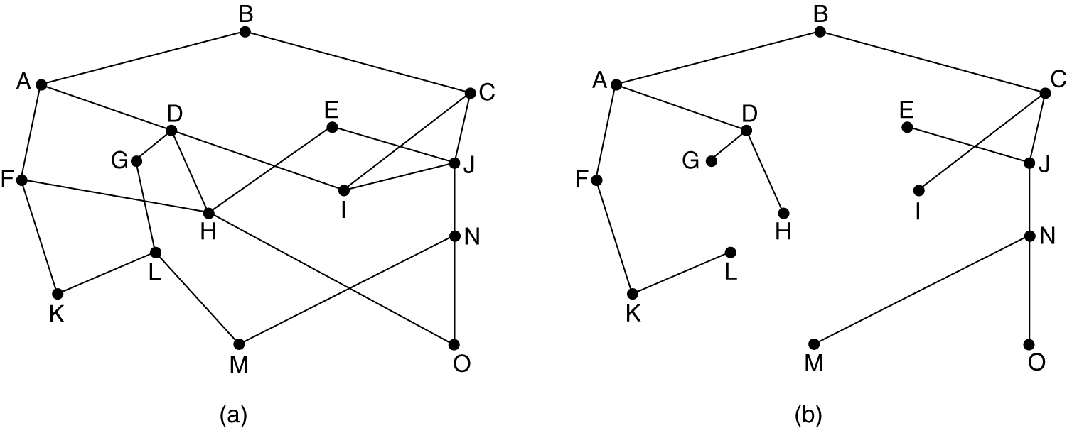
The Optimality Principle
(a) A subnet. (b) A sink tree for router B.

Slide 70
Metric used in routing algorithm
Delay
Number of hops
Distance
Bandwidth
Average traffic
Mean queue length

Slide 71
Static routing
Dijkstra’s Routing
Flooding

Slide 72
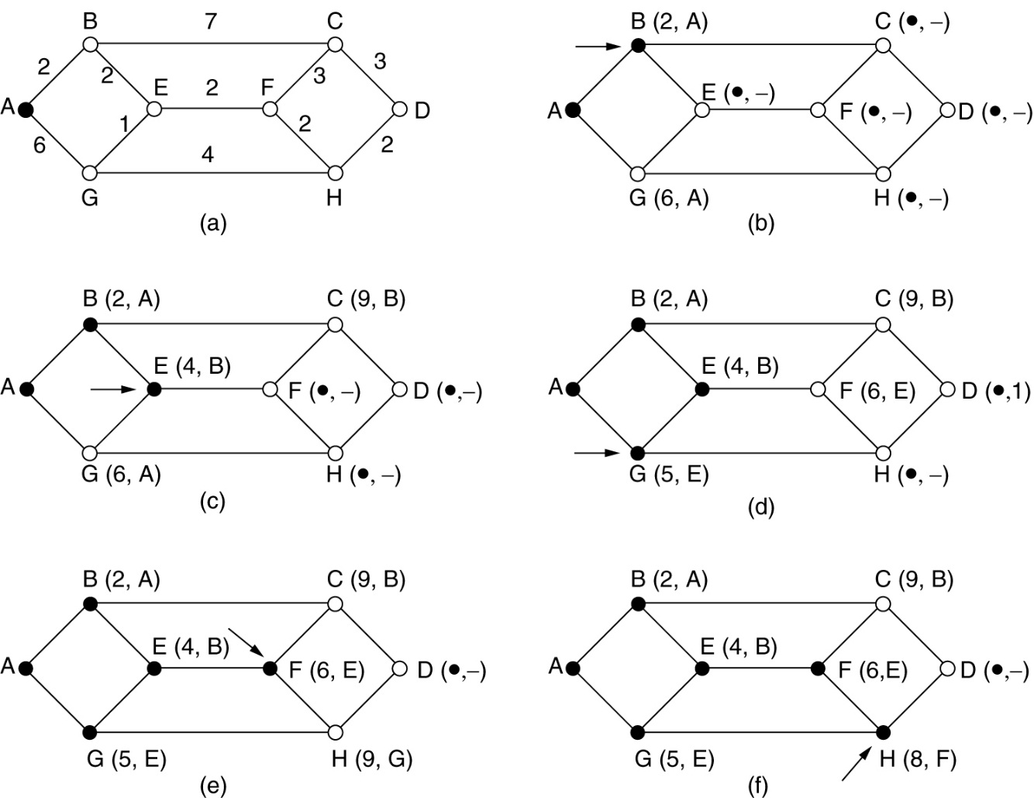
Shortest Path Routing (Dijkstra’s algorithm)

Slide 73
Flooding
Every incoming packet is sent to every outgoing line except the one it arrived on.
Problem:
Generate vast number of duplicate packets
2) Packets can infinitely routed inside network
solution :
1) Hop counter- decremented by each router, when reaches 0, packet discarded. (TTL)
2) Put sequence number in each packet. Each router needs to maintain a list per source router telling which sequence number originating at that source have already been seen.
3) Selective flooding - send the packets only to the router that are going approximately in the right direction.

Slide 74
Dynamic / Adaptive Routing algorithm
DVR (Distance vector routing algorithm
LSR (Link state Routing)
NOTE – currently DVR is used in the internet under the name RIP (Routing information protocol),
OSPF (open shortest path First) uses link state routing algorithm

Slide 75
Distance Vector
Uses Bellman-ford routing algorithm to compute shortest path.
Each router maintains a routing table indexed by, and containing one entry for each router in a subnet.
This entry contains two parts
1) the preferred outgoing line to use for that destination (Next hop)
2) Estimate of the time or distance to that destination.
The router is assumed to know the “distance” to each of its neighbors. (this is achieved using ECHO packets)
Once every T msec each router sends each neighbor a list of its estimated delays to each destinations.
It also receive a similar information from item neighboring routers.

Slide 76
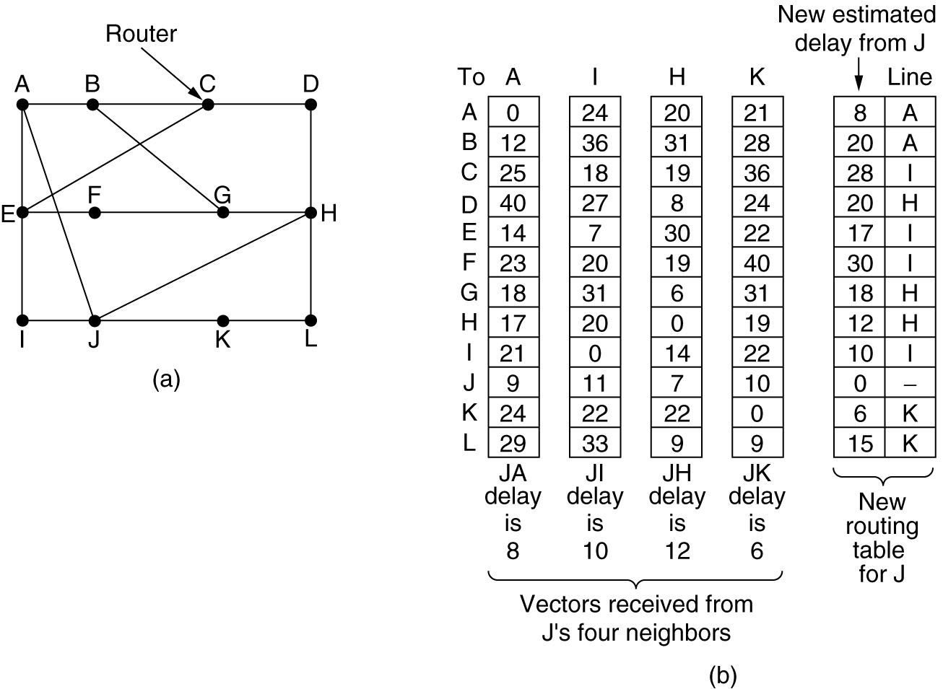
Distance Vector Routing - Example
(a) A subnet. (b) Input from A, I, H, K, and the new
routing table for J.

Slide 77
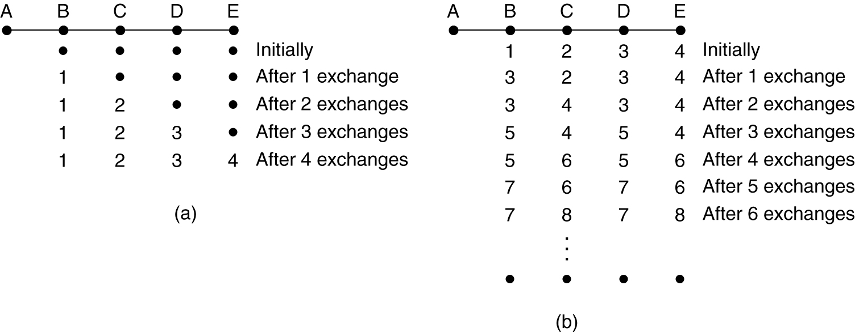
Distance Vector Routing (2)
The count-to-infinity problem.

Slide 78
Link State Routing
Each router must do the following:
Discover its neighbors, learn their network address.
Measure the delay or cost to each of its neighbors.
Construct a packet telling all it has just learned.
Send this packet to all other routers.
Compute the shortest path to every other router.

Slide 79
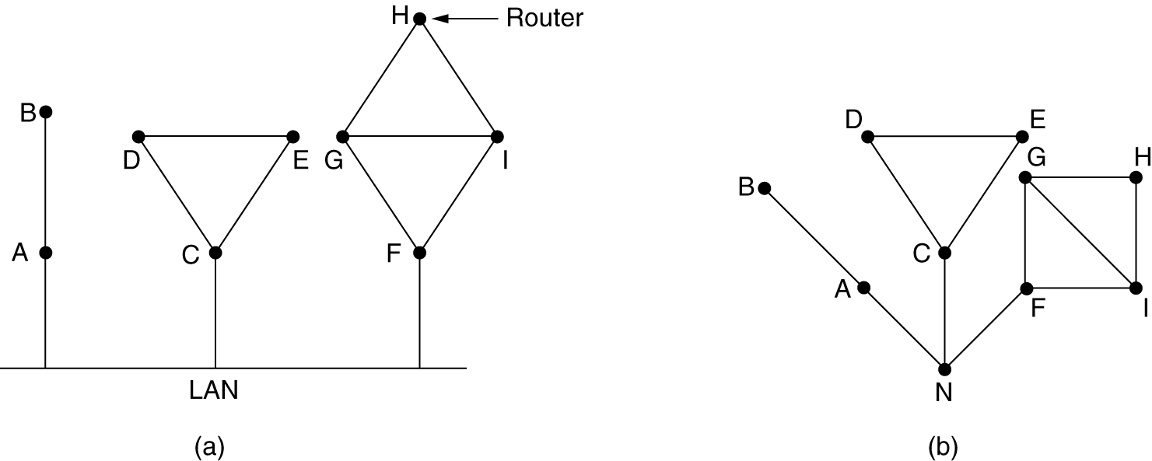
Learning about the Neighbors
Sender sends special HELLO packets on each of the outgoing lines
Receiver immediately replies telling who it is.
(a) Nine routers and a LAN. (b) A graph model of (a)

Slide 80
Measuring Line Cost
It uses delay as a metric
Special ECHO packets are sent to all out going lines.
The receiver is expected to send back the packet immediately.
By measuring the RTT/2 we het delay on that line.
Whether to take load/traffic in the link?

Slide 81
Building Link State Packets
Once the information needed for the exchange has been collected, the next step is for each router to build a packet containing all the data. These packets are called link state packets.
The packet contains following information
1) Identity of the sender
2) seq. no.
3) age
4) list of neighbors
The link state packets are build either periodically or some significant event occurs such as a neighbor going down or coming up or changing its properties.

Slide 82
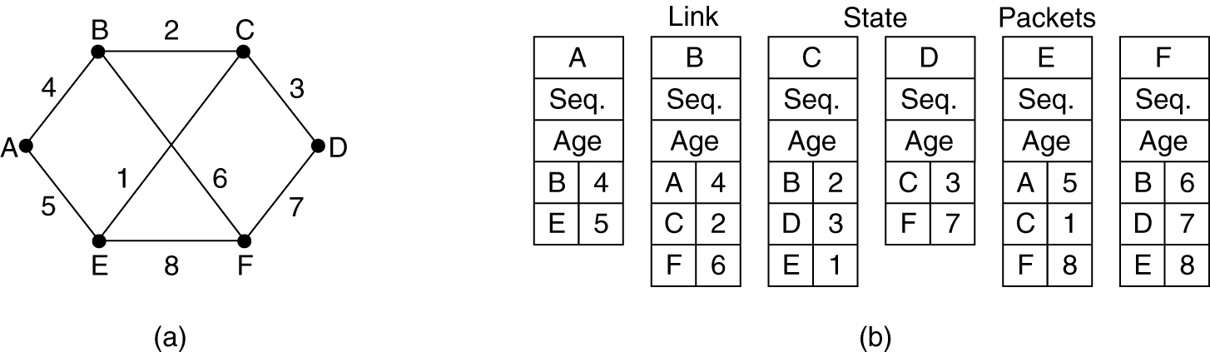
Building Link State Packets
(a) A subnet. (b) The link state packets for this subnet.

Slide 83
Distributing the link state packets
The LS packets have to be distributed reliably. As the packets are distributed and installed, the routers getting the first one will change their routes.
Consequently different routers may be using different versions of the topology, which can lead to inconsistency, loops, unreachable machines and other problems.
LSR uses flooding to distribute LS packets.
To keep the flood in check, each packet contains a sequence number, that is incremented for each packet sent.
Routers keep track of all the (source router, seq. no.) pair they see.

Slide 84
Distributing the link state packets
When a new LS packet arrives, it is checked against the list of packets already seen. If it’s a duplicate , its discarded otherwise
If a LS packet with seq. no. lesser than the highest one seen so far, it is rejected (since router has more recent data) .
If a router ever crashes and loose the track of its seq. no. and if starts again with 0. the LS packet will be rejected as a duplicate.
The age is included in each LS packet to make sure that no packet is infinitely routed in a network.
Age is decremented by every router and when it becomes 0, the packet is discarded.

Slide 85
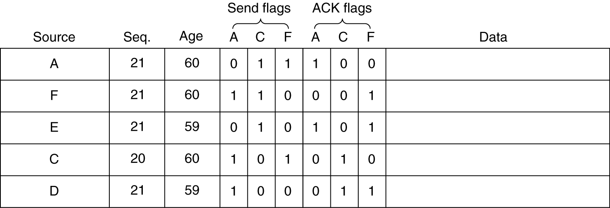
Distributing the Link State Packets
The following diagram shows the data structure maintained by router B for the given subnet.

Slide 86
Computing the routes to every node
Once the router has accumulated full set of LS packets, it can construct an entire subnet graph.
No Dijkstra’s algorithm can be run locally to find shortest path to all possible destinations. The result of the algorithm can be installed in the routing table.
Practical Example of LSR : OSPF (Open shortest path first), IS-IS system

Slide 87
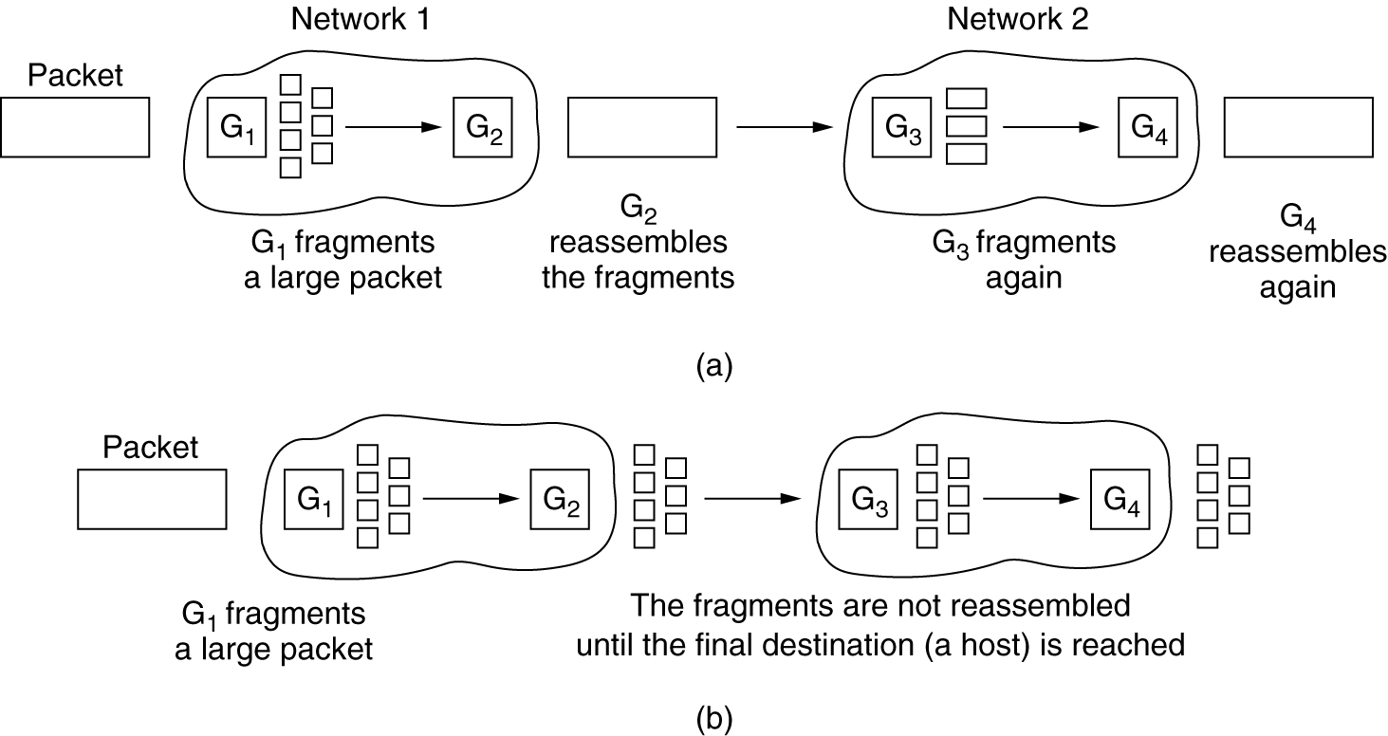
Fragmentation
(a) Transparent fragmentation. (b) Nontransparent fragmentation.

Slide 88
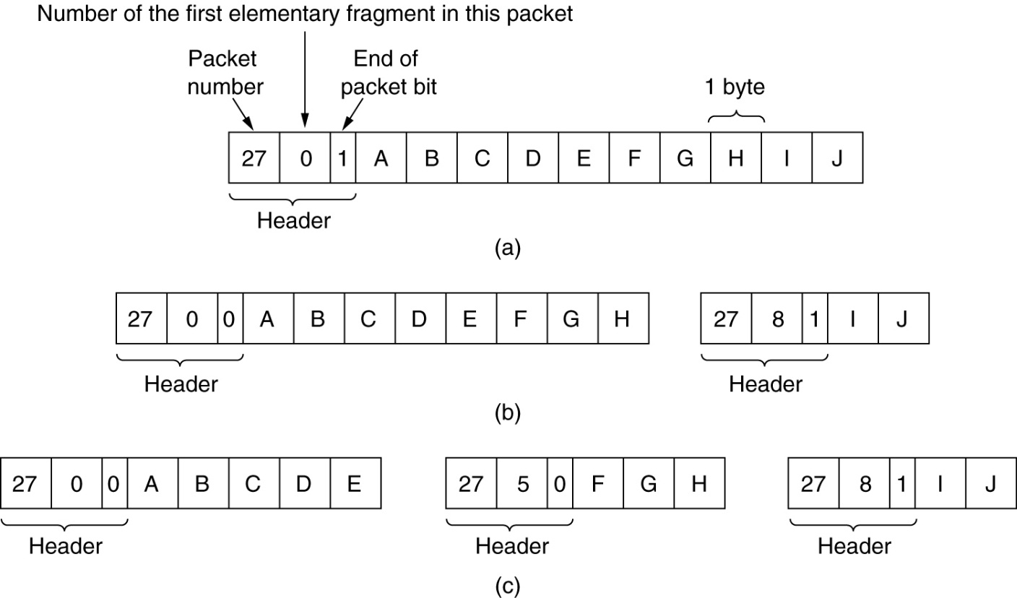
Fragmentation (2)
Fragmentation when the elementary data size is 1 byte.
(a) Original packet, containing 10 data bytes.
(b) Fragments after passing through a network with maximum packet size of 8 payload bytes plus header.
(c) Fragments after passing through a size 5 gateway.

Slide 89
Address Resolution Protocol (ARP)
Address Resolution Protocol (ARP) is a low-level network protocol for translating network layer addresses into link layer addresses.
The protocol operates below the network layer . It is at the lower levels of networking protocol (layer 2of OSI model) and it is usually run in the device drivers of the network OS

Slide 90
Addresses used by computer
IP address (Logical address) : When configuring a new network computer, each system is assigned an Internet Protocol (IP) address for primary identification and communication.
MAC Address (Physical address) : A computer also has a unique media access control (MAC) address identity. Manufacturers embed the MAC address in the local area network (LAN) card. The MAC address is also known as the computer’s physical address.

Slide 91
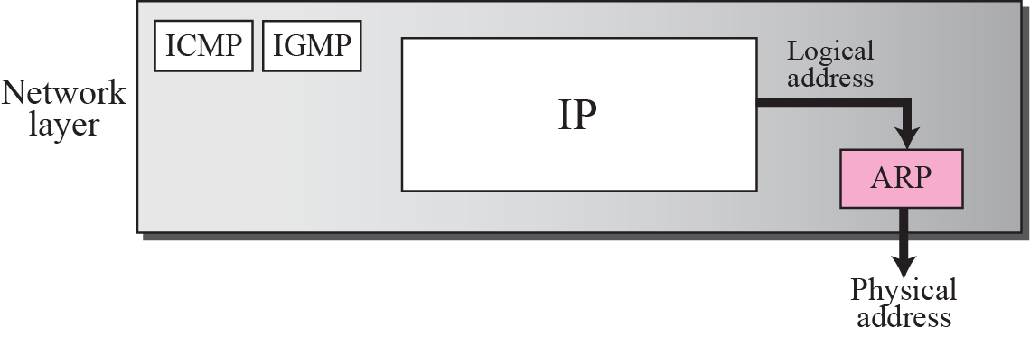
Position of ARP in TCP/IP

Slide 92
Why ARP ?
Each host in the network knows the Logical address of another host.
Now, suppose a host needs to send the IP datagram to another host.
But, the IP datagram must be encapsulated in a frame so that it can pass through the physical network between sender and receiver.
Here, the sender needs the physical address of the receiver so that it is being identified that to which receiver the packet belong to when the packet travel in the physical network.

Slide 93
Working
The sender sends the ARP query packet on the network which is broadcasted to all the other host or router present in the network.
The ARP query packet contains the logical and physical address of the sender and the logical address of the receiver.
All the host and router receiving the ARP query packet process it but, only the intended receiver identifies its logical address present in the ARP query packet.
The receiver then sends ARP response packet which contains the logical (IP) address and physical address of the receiver.
The ARP response packet is unicast directly to the sender whose physical address is present in the ARP query packet.

Slide 94
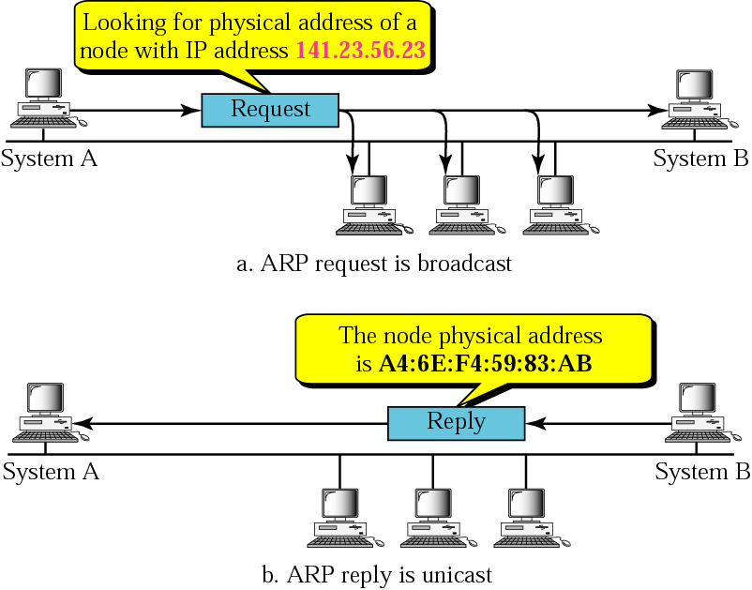

Slide 95
ARP Cache
For every outgoing packet sending ARP request and waiting for responses is inefficient
Requires more bandwidth
Consumes Time
ARP cache maintained at each node
Size limit = 512 entries (timer)

Slide 96
ARP Cache Table
If ARP just resolved an IP address, chances are a few moments later someone is going to ask to resolve the same IP address
When ARP returns a MAC address, it is placed in a cache. When the next request comes in for the same IP address, look first in the cache

Slide 97
Cache Table
Each host maintains a table of IP to MAC addresses
Message types:
ARP request
ARP reply
ARP announcement

Slide 98
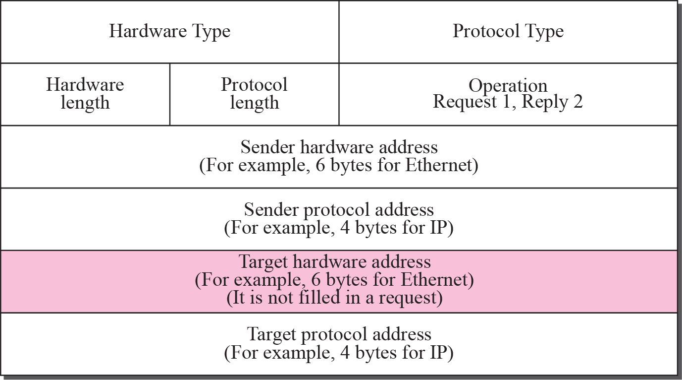
The ARP Packet Format

Slide 99
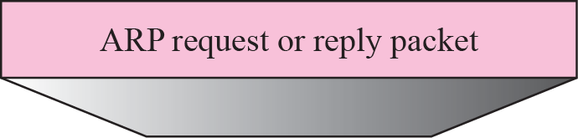
Figure Encapsulation of ARP packet

Slide 100
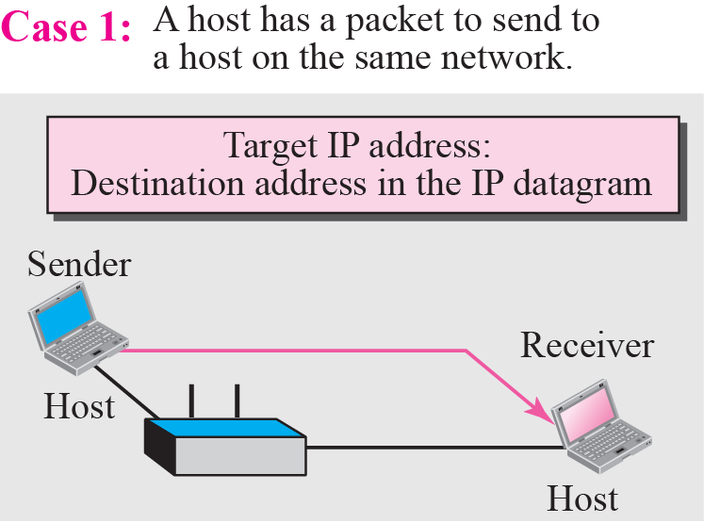
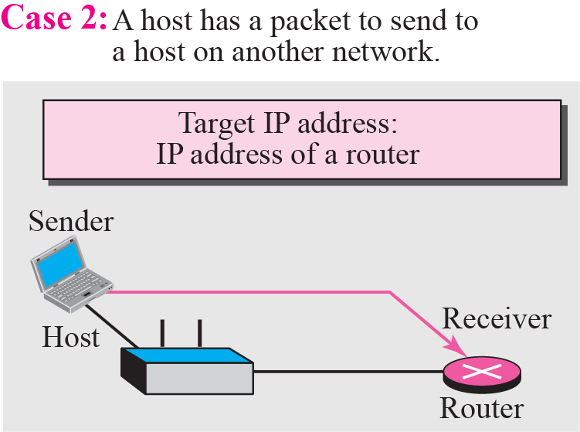
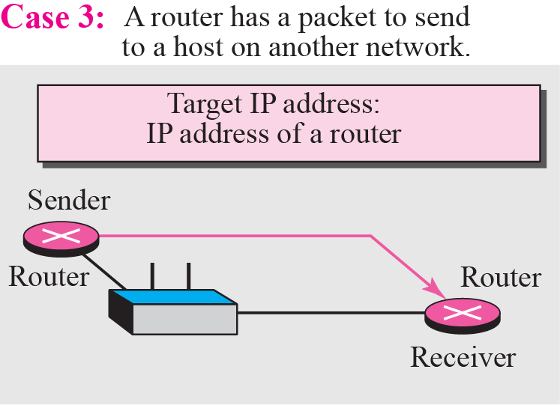
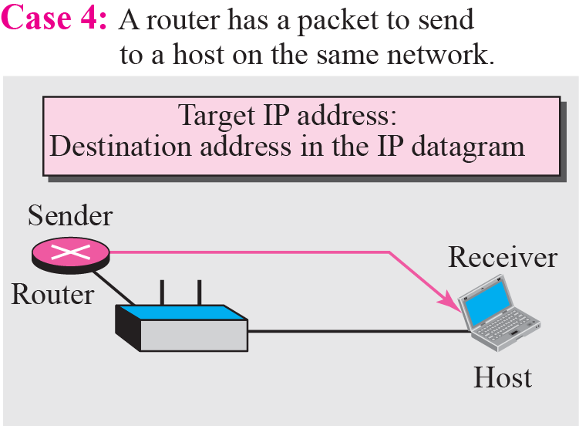
Figure Four cases using ARP

Slide 101
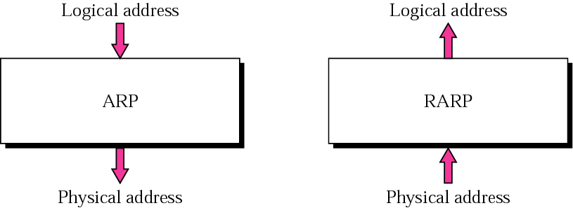
Reverse ARP
Given a MAC (Physical address) find corresponding IP address

Slide 102
RARP
RARP (Reverse Address Resolution Protocol) is also a network layer protocol.
ARP is a TCP/IP protocol that allows any host to obtain its IP address from the server.
RARP is adapted from the ARP protocol and it is just reverse of ARP.
RARP perform following steps to obtain an IP address from the server.
The sender broadcast the RARP request to all the other host present in the network.
The RARP request packet contains the physical address of the sender.
All the host receiving the RARP request packet process it but, the authorized host only which can serve RARP service, responds to the RARP request packet such host are known as RARP Server.
The authorized RARP server replies directly to requesting host with the RARP response packet which contains IP address for the sender.

Slide 103
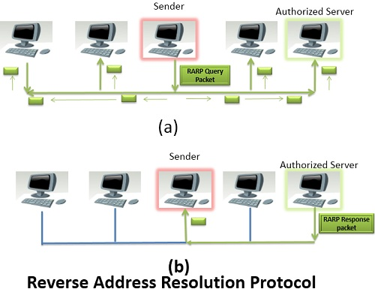

Slide 104
NOTE
RARP is outdated now because of two reasons. First, the RARP is using the broadcast service of the data-link layer; that means the RARP must be present at each network.
Second, RARP only provides IP address but today the computer also need other information.
RARP has been replaced by BOOTP and DHCP.

Slide 105
ICMP- Internet Control Message Protocol
The IP (Internet Protocol) relies on several other protocols to perform necessary control and routing functions:
Control functions (ICMP)
Multicast signaling (IGMP)
Setting up routing tables (RIP, OSPF, BGP, PIM, …)

Slide 106
Overview
The Internet Control Message Protocol (ICMP) is a helper protocol that supports IP with facility for
Error reporting
Simple queries
ICMP messages are encapsulated as IP datagrams:

Slide 107
ICMP message format
4 byte header:
Type (1 byte): type of ICMP message
Code (1 byte): subtype of ICMP message
Checksum (2 bytes): similar to IP header checksum. Checksum is calculated over entire ICMP message
If there is no additional data, there are 4 bytes set to zero. → each ICMP messages is at least 8 bytes long

Slide 108
ICMP Query message
ICMP query:
Request sent by host to a router or host
Reply sent back to querying host

Slide 109
Example of ICMP Queries
Type/Code: Description
8/0 Echo Request
0/0 Echo Reply
13/0 Timestamp Request
14/0 Timestamp Reply
10/0 Router Solicitation
9/0 Router Advertisement
The ping command uses Echo Request/ Echo Reply

Slide 110
Example of a Query: Echo Request and Reply
Ping’s are handled directly by the kernel
Each Ping is translated into an ICMP Echo Request
The Ping’ed host responds with an ICMP Echo Reply
Host or Router
Host or router
ICMP ECHO REQUEST
ICMP ECHO REPLY

Slide 111
Example of a Query: ICMP Timestamp
Sender
Timestamp Request
A system (host or router) asks another system for the current time.
Time is measured in milliseconds after midnight UTC (Universal Coordinated Time) of the current day
Sender sends a request, receiver responds with reply
Receiver
Timestamp Reply

Slide 112
ICMP Error message
ICMP error messages report error conditions
Typically sent when a datagram is discarded
Error message is often passed from ICMP to the application program

Slide 113
ICMP Error message
ICMP error messages include the complete IP header and the first 8 bytes of the payload (typically: UDP, TCP)

Slide 114
Frequent ICMP Error message
Type | Code | Description
3 | 0–15 | Destination unreachable | Notification that an IP datagram could not be forwarded and was dropped. The code field contains an explanation.
5 | 0–3 | Redirect | Informs about an alternative route for the datagram and should result in a routing table update. The code field explains the reason for the route change.
11 | 0, 1 | Time exceeded | Sent when the TTL field has reached zero (Code 0) or when there is a timeout for the reassembly of segments (Code 1)
12 | 0, 1 | Parameter problem | Sent when the IP header is invalid (Code 0) or when an IP header option is missing (Code 1)

Slide 115
Some subtypes of the “Destination Unreachable”
Code | Description | Reason for Sending
0 | Network Unreachable | No routing table entry is available for the destination network.
1 | Host Unreachable | Destination host should be directly reachable, but does not respond to ARP Requests.
2 | Protocol Unreachable | The protocol in the protocol field of the IP header is not supported at the destination.
3 | Port Unreachable | The transport protocol at the destination host cannot pass the datagram to an application.
4 | Fragmentation Needed and DF Bit Set | IP datagram must be fragmented, but the DF bit in the IP header is set.

Slide 116
IGMP

